Slide 1
BITS Pilani
CS F363: Compilers
Tut-3

Slide 2
Exercise-0
Consider the following grammar for an if-else statement:
if_stmt -> if (<expr>) <stmt> |
if (<expr>) <stmt> else <stmt>
<stmt> -> <if_stmt> | …
Give an example where the parse tree according to this grammar is ambiguous.
Modify this grammar to fix the ambiguity.

Slide 3
Exercise-0 (contd)
if (A) if (B) C else D can be parsed as
  if (A)
  if (B) C else D; // else matched with second if
  if (A)
  if (B) C;
  else D; // else matched with first if
The most common way to resolve this ambiguity is to match an else clause with the nearest unmatched if.
<if_stmt> -> <matched> | <unmatched>
<matched> -> if (<expr>) <matched> else <matched> | <non_if_stmt>
<unmatched> -> if (<expr>) <if_stmt> |
if (<expr>) <matched> else <unmatched>

Slide 4
Example 1:
Simplify the grammar by removing Left-factoring
A → a A B | a B c | a A c
Solution: A → a A′
A′ → A B | B c | A c
this further can be re-write to A′ →AD | Bc and D → B | c

Slide 5
Example 2:
Consider the following grammar and eliminate left recursion-
A → ABd / Aa / a
B → Be / b
Solution:
The grammar after eliminating left recursion is-
A → aA’
A’ → BdA’ / aA’ / ∈
B → bB’
B’ → eB’ / ∈

Slide 6
Example 3:
Simplify the grammar by removing unit productions, Left-factoring, left-recursion elimination
X → cYer
Y → Yl | Ypi | Zm
Z → o
After removing unit production
X → cYer
Y → Yl | Ypi | om

Slide 7
After performing the Left-factoring for Y
X → cYer
Y → YY’ | om
Y’ → l | pi
After eliminating the Left-recursion in Y
X → cYer
Y → om | omZ
Z → Y’ | Y’Z
Y’ → l | pi

Slide 8
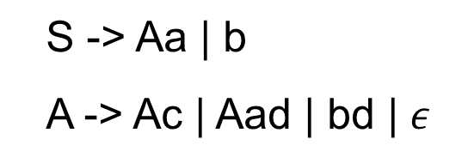
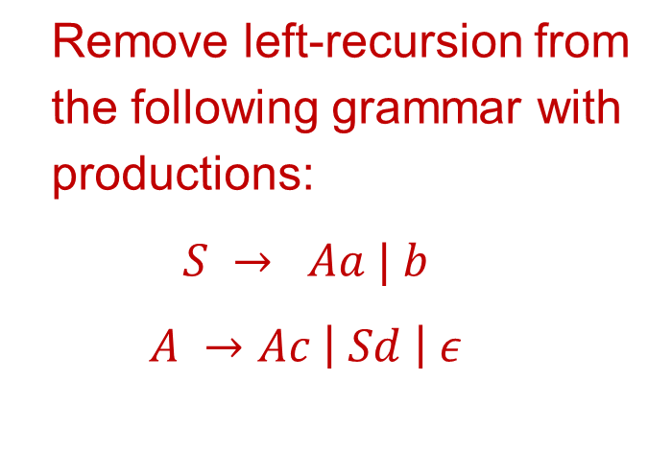
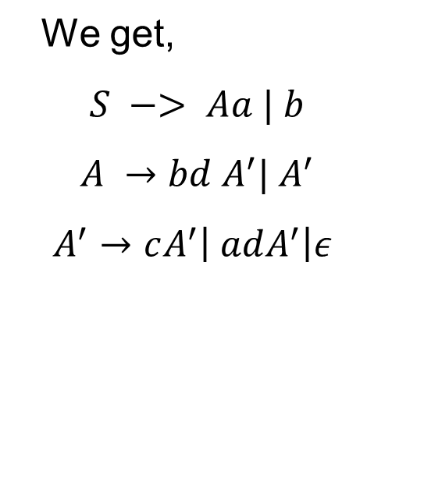
Example 4: Eliminating indirect left recursion
Algorithm for eliminating indirect recursion
List the nonterminals in some order A₁, A₂, ...,A_{n}
for i=1 to n
for j=1 to i-1
if there is a production A_{i}→Ajα,
replace Aj with its rhs
eliminate any direct left recursion on A_{i}
Order the variables: S, A
For i=A and j =S we have

Slide 9
Example 5: Eliminating indirect left recursion
ordering: S, E, T, F
i=S
i=E
i=T, j=E
S → E
E → E+T
E → T
T → E-T
T → F
F → E*F
F → id
S → E
E → E+T
E → T
T → E-T
T → F
F → E*F
F → id
S → E
E → TE'
E'→+TE'|ε
T → E-T
T → F
F → E*F
F → id
S → E
E → TE'
E'→+TE'|ε
T → TE'-T
T → F
F → E*F
F → id
Algorithm for eliminating indirect recursion
List the nonterminals in some order A₁, A₂, ...,A_{n}
for i=1 to n
for j=1 to i-1
if there is a production A_{i}→Ajα,
replace Aj with its rhs
eliminate any direct left recursion on A_{i}
S → E
E → TE'
E'→+TE'|ε
T → FT'
T' → E'-TT'|ε
F → E*F
F → id
Notes:
When i=1 eliminate all immediate left recursion in S no recursion hence nothing happens
i=2

Slide 10
Eliminating indirect left recursion
i=F, j=E
i=F, j=T
S → E
E → TE'
E'→+TE'|ε
T → FT'
T' → E'-TT'|ε
F → TE'*F
F → id
S → E
E → TE'
E'→+TE'|ε
T → FT'
T' → E'-TT'|ε
F → FT'E'*F
F → id
S → E
E → TE'
E'→+TE'|ε
T → FT'
T' → E'-TT'|ε
F → idF'
F' → T'E'*FF'|ε

Slide 11
Exercise 6
Consider the following grammar and answer questions i-iii.
S -> (L) | a
L -> L,S | S
You are asked to implement a RDP, what problem do you encounter and why?
What transformation is required to make it parsable by RDP?
After the transformation show how you implement function S using RDP. [note: you need not show functions for main, match and L]

Slide 12
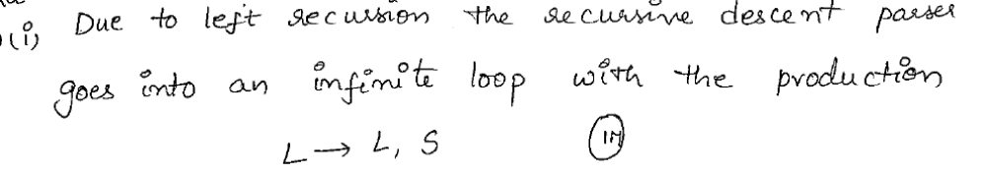
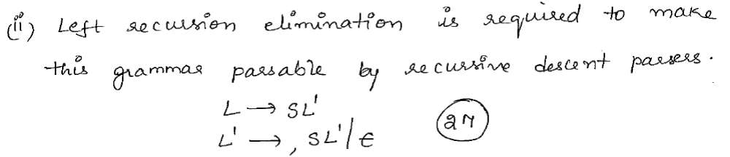
Exercise 6 (Contd..)

Slide 13
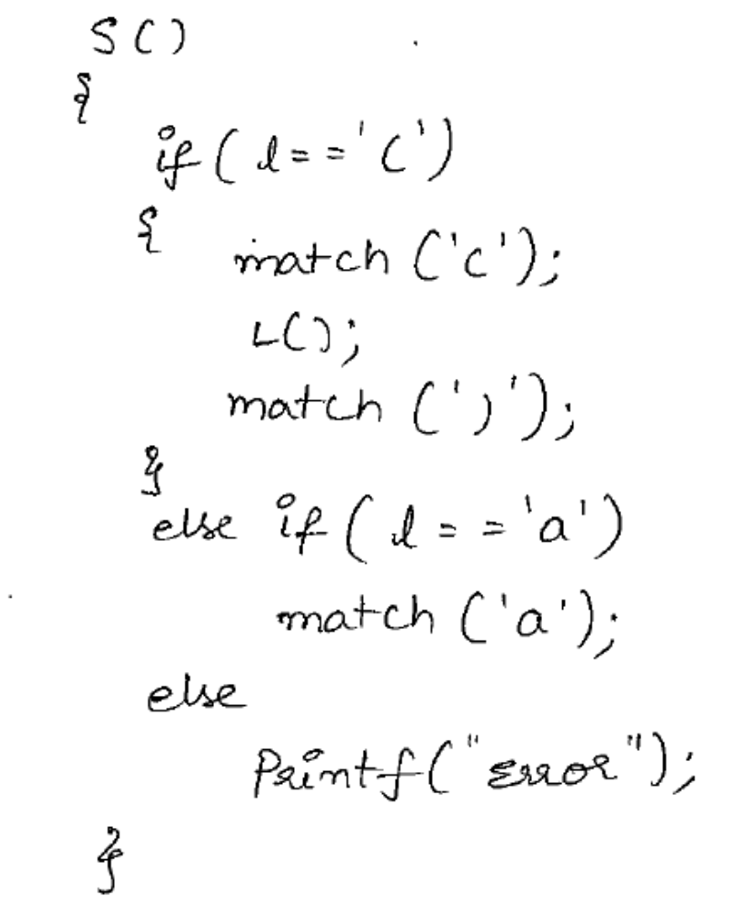
Exercise 6 (Contd..)

Slide 14
Write a Recursive Descent parsing function for the following grammar
E →B A
A → & B A | ϵ
B → true | false
void A() {
token= get-next-token();
if ( token == '&' ) {
B();
A();
}
else return;
}
void E() {
B();
A();
token= get-next-token();
if ( token != EOF ) error();
}
void B() {
token= get-next-token();
if ( token == "true" || token == "false" )
else
error();
}

Slide 15
Recursive descent parser – Take home exercises
Construct recursive-descent parsers, starting with the following grammars:
1. S->ABd | aBc
A -> є
B->b|c
2. S -> + S S | - S S | a
3. S -> S ( S ) S | ε
4.S -> 0 S 1 | 0 1

Slide 16
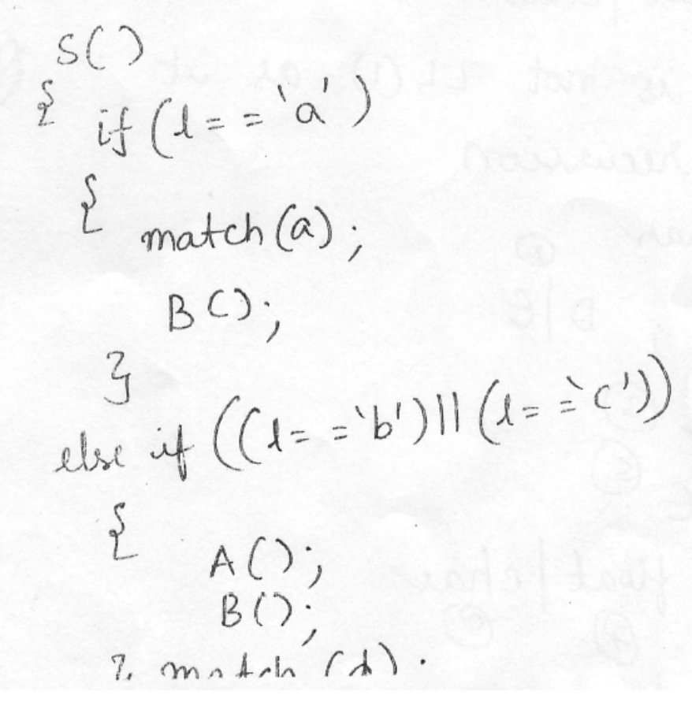
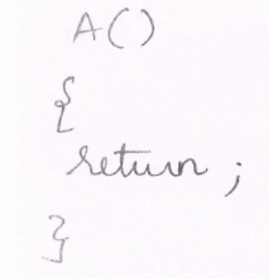
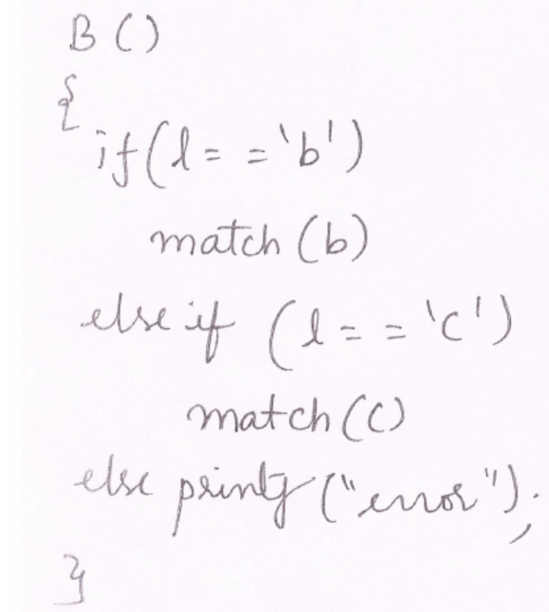
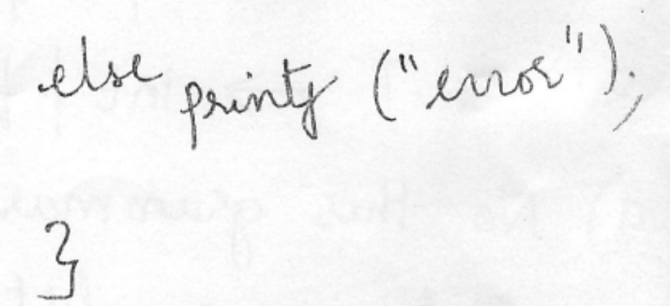
Recursive descent parser – Take home exercises
S->ABd | aBc
A -> є
B->b|c

